Slide 1

Sample program:
# My first program
# Subroutine to output text
def OutputText():
print("Hello World")
# Main program
OutputText()
Notes:
Predict what you think this program does.
Type in the code and run it to see if you were right.
If your code does not work, you need to do what is called “debugging” and check each line of your program has been input correctly.
Have you typed every line of code exactly as you see it?
Have you used a tab before print("Hello World"), not spaces?
Are the commands such as def and print in lowercase?
Have you missed the colon at the end of the line def OutputText():?
It is a custom in computer science to write Hello World as your first program when you learn a new programming language.

Slide 2
Understand how the code works:
# My first program
# Subroutine to output text
def OutputText():
print("Anyone can write code that computers understand. Good programmers write code humans can understand.")
# Main program
OutputText()
# My first program
# Subroutine to output text
def OutputText():
print("I am learning to code…\n…and it is fun")
# Main program
OutputText()
Programs should start with a comment stating the purpose of the program.
Comments are identified with the hash # symbol.
Programs should be structured into sections of code called subroutines.
Subroutines are identified with the def keyword.
Each subroutine should start with a comment to explain what it does.
The program actually starts to run from here.
OutputText() means run the code inside the subroutine called OutputText.
Notes:
Change the program so that it outputs the following text instead: Anyone can write code that computers understand. Good programmers write code humans can understand. This is a famous quote from Martin Fowler, a British software developer. It explains why you should use comments and subroutines.
Change the program so that it outputs the following text on two lines: I am learning to code… …and it is fun

Slide 3
Sample program:
# Using variables and constants
# Subroutine to calculate price
def Discount(Total, Rate):
return Total - (Total * Rate/100)
# Main program
print(Discount(60,50))
Notes:
Predict what you think this program does.
Type in the code and run it to see if you were right.
If your code does not work, you have a bug and need to debug it:
Have you typed every line of code exactly as you see it?
Have you used a tab before the command return?
Are the commands such as def and print in lowercase?
Have you missed the colon at the end of the line def OutputText():?
Find out, why are errors in code called bugs?

Slide 4
This program calculates a price by applying a percentage discount.
Understand how the code works:
# Using variables and constants
# Subroutine to calculate price
def Discount(Total, Rate):
return Total - (Total * Rate/100)
# Main program
print(Discount(55,20))
The number 60 is put into Total. The number 50 is put into Rate. These are known as variables – the name for a piece of memory to store our data.
The calculation happens here with the result being returned from the subroutine.
The retuned result from Discount is output to the screen.
START HERE
The program starts here by running the subroutine called Discount. Discount needs two pieces of data. The price and the percentage discount separated by a comma. Because these values can never change when the program is running, they are known as constants.
Notes:
Change the program so that it calculates a 20% discount from £55.

Slide 5
Sample program:
# Using variables and constants
# Subroutine to calculate price
def FlowRate(Volume, Time):
return Volume / Time
# Main program
Volume = 330
Time = 4
Heart = FlowRate(Volume, Time)
print("The flow rate of the human heart is", Heart, "ml/s")
Notes:
Predict what you think this program does.
Type in the code and run it to see if you were right.
If your code does not work, you need to debug it:
Have you typed every line of code exactly as you see it?
Have you used a tab before the command return?
Are the commands such as def and print in lowercase?
Have you missed the colon?

Slide 6
This program calculates the flow rate of blood from the heart.
Understand how the code works:
# Using variables and constants
# Subroutine to calculate price
def FlowRate(Volume, Time):
return Volume / Time
# Main program
Volume = 100
Time = 30
IV = FlowRate(Volume, Time) * 60
print(f”IV flow rate is {IV}mL/hr”)
These variables called Volume and Time are different variables to Volume and Time in the Main program. They just happen to have the same name!
You can store the values of constants with meaningful names. Note the use of comments helps to explain the units here too.
You can join a string to a variable. This is called concatenation.
Notes:
Change the program so that it calculates the flow rate of an IV infusion flow pump. Use the formula, volume (ml) divided by time (min), multiplied by 60 min. This equals the IV flow rate in mL/hr. Using this formula, 100 ml divided by 30 minutes, times 60 minutes in 1 hour, equals 200 ml/hr.

Slide 7
Learning points from this objective:
Programs are structured into smaller subroutines.
Subroutines that do not return any values are called procedures. Subroutines that return values are called functions.
Code inside subroutines is tabulated. This helps to make it more readable, but it also tells the computer what code belongs to the subroutine.
Comments are used at the beginning of programs and subroutines to explain their purpose. Larger programs are often written by teams of programmers, so this helps other people understand your code and for you to remember how it worked too!
Keywords are the words that the programming language uses for instructions. E.g. print. Keywords are also called reserved words because you cannot use them for other purposes in your program. e.g. you cannot call a subroutine print.
Python is case sensitive. This means that keywords must be entered in the correct case.
Text in a program is called a string. It is a string of characters.
Strings are qualified with double quote marks. E.g. “This is a string” to show where the text starts and ends.
Constants are values in a program that can only be changed by the programmer. The program does not change them when it is running.
Variables are places in memory where values are stored. They are given an identifier to name them.
Variables have a data type that describes the data they are storing, e.g. string, float etc. This reserves the correct amount of memory for the data. Specifying the data type is not necessary in Python.
The name of a variable is called an identifier.
Different variables can have the same identifier in different subroutines.
When variables are given a value they are said to be assigned. Giving a variable an initial value is called initialising the variable.
Notes:
Read the summary of the key learning points for this objective.

Slide 8
Learning points from this objective:
Strings can be joined to variables. This is known as concatenation.
When constants or variables are used as data given to subroutines, this is called parameter passing. The data is called a parameter.
Running a program is called executing a program. Executing one command after another is called a sequence.
If a program doesn’t work, it is said to have a “bug”. Fixing bugs is called, “debugging”.
Notes:
Read the summary of the key learning points for this objective.

Slide 9
Program comprehension:
def Sq(X):
return X * X
9 = A
print(A,"squared:",Sq(A))
ITEM | Identify a string in the program.
 | “squared:”
 | Identify the name of a subroutine in the program.
 | Sq()
STRUCTURE | Debug line 3.
 | A = 9
 | Identify the line where the number 9 is squared.
 | 2
Notes:
Answer the questions in the tables using the sample code on this slide.
Enter your answer in the row under the question.

Slide 10
Program comprehension:
def Sq(X):
return X * X
9 = A
print(A,"squared:",Sq(A))
PURPOSE | What is the purpose of the comma , in line 4?
 | String concatenation
 | What does the command print in line 4 do?
 | Print an output to the terminal
REASON | Why is a double quote " needed around squared in line 4?
 | It is a string, not a variable or subroutine
 | Why does X have the same value as A?
 | Because the function Sq takes the input A and sets X to be equal to A
Notes:
Answer the questions in the tables using the sample code on this slide.
Enter your answer in the row under the question.

Slide 11
Keywords introduced in this objective:
def subroutine() | Starts and names a new subroutine.
X = "Hello" X = 6 | Assigns X to be the string “Hello”. Assigns X to hold the value 6.
return X return X,Y | Returns a value X from the subroutine into another function or variable. More than one value can be returned if separated with commas.
X = Subroutine(y,z) X,Y = Subroutine(Z) | Assigns X to the returned value from Subroutine, passing Y and Z as data parameters. Y and Z are optional. Subroutines accept zero or more parameters of any data type. It is possible to return multiple values.
print("string") | Outputs text string to the screen.
print("string", X) | Outputs text string concatenated with X to the screen. A comma inserts a space in-between. Using + instead does not insert a space.
print("Hello",end="") print("World") | Using end="" prevents a new line between print statements.
Notes:
Use these keywords you learned as a handy reference when you make your own programs.

Slide 12

# Dice face 5 problem
Dice face 5 problem:
1 point.
Write a subroutine that will output the number 5 on a dice like this:
ooooooooooo
o o
o # # o
o # o
o # # o
o o
ooooooooooo
# Subroutine to output text
print("ooooooooooo")
def Output5():
print("o # o")
print("o # # o")
Output5()
print("o # # o")
print("o o")
# Main program
print("ooooooooooo")
To help you get started, here is all the code you need with the statements jumbled up.
print("o o")
Notes:
Have a go at some of the problems using what you have learned in this objective.
Only use the commands that you have been shown in the example programs.
Avoid using commands that you have not been taught because you may not be able to use these when answering exam questions.
If your teacher does not direct you, aim to achieve 6 points in total in this objective.

Slide 13

# Temperature converter problem
Temperature converter problem:
1 point.
Write two subroutines that convert between centigrade and Fahrenheit using the formula: F = (C * 1.8) + 32
One subroutine takes the temperature in degrees centigrade as a parameter and returns Fahrenheit. The second subroutine takes the temperature in degrees Fahrenheit as a parameter and returns centigrade.
E.g. 30°C = 86°F (30°C * 1.8) + 32 = 86°F
# Subroutine to convert Centigrade to Fahrenheit
def FtoC(F):
def CtoF(C):
# Main program
C = 30
F = CtoF(C)
# Subroutine to convert Fahrenheit to Centigrade
return (C * 1.8) + 32
return (F / 1.8) - 32
To help you get started, here is all the code you need with the statements jumbled up.
print(C,"degrees C is",F,"degrees F")
Notes:
Have a go at some of the problems using what you have learned in this objective.
Only use the commands that you have been shown in the example programs.
Avoid using commands that you have not been taught because you may not be able to use these when answering exam questions.
If your teacher does not direct you, aim to achieve 6 points in total in this objective.

Slide 14


Characters problem:
1 point.
Write a program to produce the following output:
The digits are: 0123456789
The characters are: abcdABCD@#!£
The alphanumerics are: 0123456789 abcdABCD@#!£
Notes:
Have a go at some of the problems using what you have learned in this objective.
Only use the commands that you have been shown in the example programs.
Avoid using commands that you have not been taught because you may not be able to use these when answering exam questions.
If your teacher does not direct you, aim to achieve 6 points in total in this objective.

Slide 15




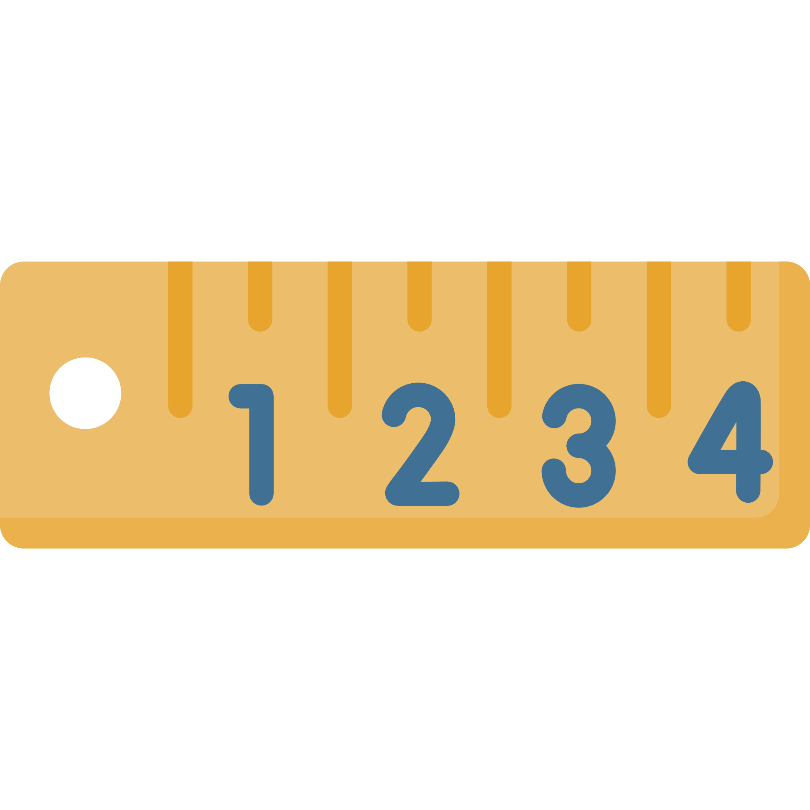
Fish tank volume problem:
2 points.
Write a subroutine that will output the volume of a fish tank. To calculate volume in litres, multiply length by depth by height and divide by 1000.
Microscopy problem:
2 points.
The actual size of a cell viewed under a light microscope is 80μm (micrometres). It measures 4cm on the slide. Calculate the magnification.
The size on the slide multiplied by 10,000 converts the measurement to μm. Divide this by the actual size to determine the magnification.
Notes:
Have a go at some of the problems using what you have learned in this objective.
Only use the commands that you have been shown in the example programs.
Avoid using commands that you have not been taught because you may not be able to use these when answering exam questions.
If your teacher does not direct you, aim to achieve 6 points in total in this objective.

Slide 16

Fish tank volume problem:
2 points.
Write a subroutine that will output the volume of a fish tank. To calculate volume in litres, multiply length by depth by height and divide by 1000.
Carpet cost problem:
2 points.
Write a subroutine that outputs the cost of fitting a carpet using 3 parameters:
Width of the room in metres.
Length of the room in metres.
Price of carpet per m².
Underlay for the carpet will also be required at £3 per m².
Grippers will be required at £1/m: width * 2 + length * 2
The fitting fee is £50.
Test the program with a 7 x 6m room and a £17m² carpet.
E.g. 7m x 6m room with a £17 carpet = £714 + £126 + £26 + £50 = £916
Notes:
Have a go at some of the problems using what you have learned in this objective.
Only use the commands that you have been shown in the example programs.
Avoid using commands that you have not been taught because you may not be able to use these when answering exam questions.
If your teacher does not direct you, aim to achieve 6 points in total in this objective.

Slide 17


Energy bill calculator problem:
3 points.
Write a subroutine that will output the raw cost of energy usage by taking three parameters: previous meter reading, current reading and calorific value.
The units used equals the current reading minus the previous reading.
kWh = units used * 1.022 * calorific value divided by 3.6.
The calorific value varies a little by each supplier, are governed by legislation and provided by the National Grid. Assume a value of 39.3.
Energy is charged at 2.84p per kWh.
You do not need to format the output because the result is the input to further calculations.
Circle properties problem:
3 points.
Write a subroutine that outputs the following properties of a circle from the diameter and arc angle:
The radius of the circle (diameter divided by 2).
The area of the circle (3.14 multiplied by the radius squared).
The circumference of the circle (3.14 multiplied by the diameter).
The arc length (circumference multiplied by the arc angle), divided by 360.
sector
arc length
radius
arc angle
diameter
circumference
Notes:
Have a go at some of the problems using what you have learned in this objective.
Only use the commands that you have been shown in the example programs.
Avoid using commands that you have not been taught because you may not be able to use these when answering exam questions.
If your teacher does not direct you, aim to achieve 6 points in total in this objective.

Slide 18

Ball pit problem:
3 points.
The number of balls needed to fill a children’s ball pit can be calculated as: the volume of the ball pit divided by the volume of a single ball multiplied by the packing density.
The packing density is generally 0.75.
The volume of the ball pit is calculated as: Pi (3.14) * radius² * height of the ball pit.
The volume of a ball is calculated as: (4/3) * Pi (3.14) * radius³.
Write a function to return the volume of the ball pit from two parameters: ball pit radius and ball pit height.
Write a function to return the volume of a ball from one parameter: ball radius.
The program should output the number of balls required to fill a pit with a radius of 1m and height of 0.2m using 0.05m balls.
Notes:
Have a go at some of the problems using what you have learned in this objective.
Only use the commands that you have been shown in the example programs.
Avoid using commands that you have not been taught because you may not be able to use these when answering exam questions.
If your teacher does not direct you, aim to achieve 6 points in total in this objective.

Slide 19
Review your solutions:
Did you: | Self-assess: Yes/No
Complete all the requirements for the problems you solved?
Start your programs with a comment to describe what they do?
Use a subroutine for the main algorithm in your code?
Use a comment to describe what the subroutine does?
Use variable names that describe the data they hold?
Notes:
Self assess your work by evaluating your solutions against these criteria. Enter yes or no in the “Self-assess” column.
Once you have completed the objective, show your programs to your teacher so you can review them together.

